Slide 1
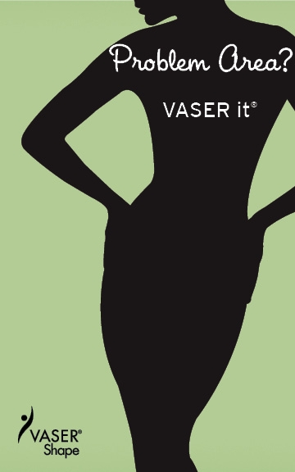
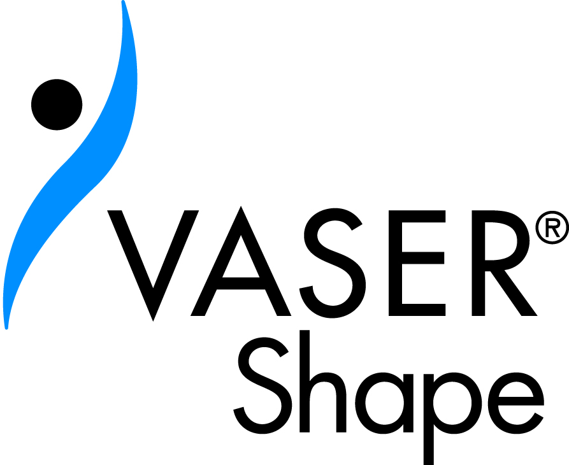
The Woman’s Group
Tampa, Florida

Slide 2
Why Consider VASER® Shape
You have problem areas resistant to diet and exercise
You have visible cellulite that bothers you
You want to feel more confident about your body
You want your clothes to fit better
You want a treatment that is quick, painless and requires NO downtime

Slide 3
What is VASER® Shape
VASER Shape is a safe and effective body shaping treatment that can smooth, firm and shape those troublesome problem areas to give you the body you desire.
No Anesthesia
No Pain
No Downtime
Reduces the Appearance of Cellulite
Treats a Variety of Body Areas
For Men & Women
Non-Surgical
Proven & Measureable Results
Noticeable Results in Just 1 Hour
No Additional Diet /Exercise Plans

Slide 4
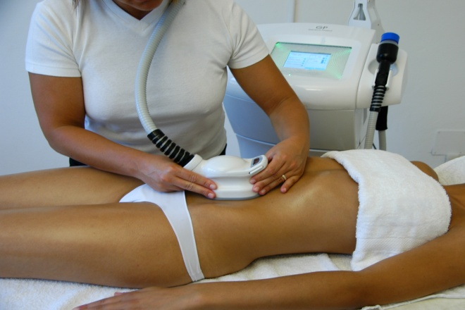
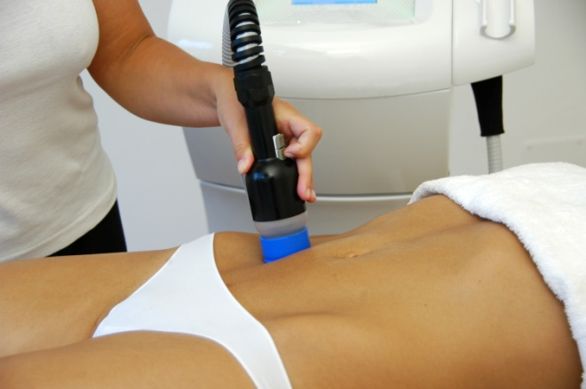
How VASER® Shape Works
VASER Shape combines ultrasound and massage to treat fatty tissue underneath the skin.

Slide 5
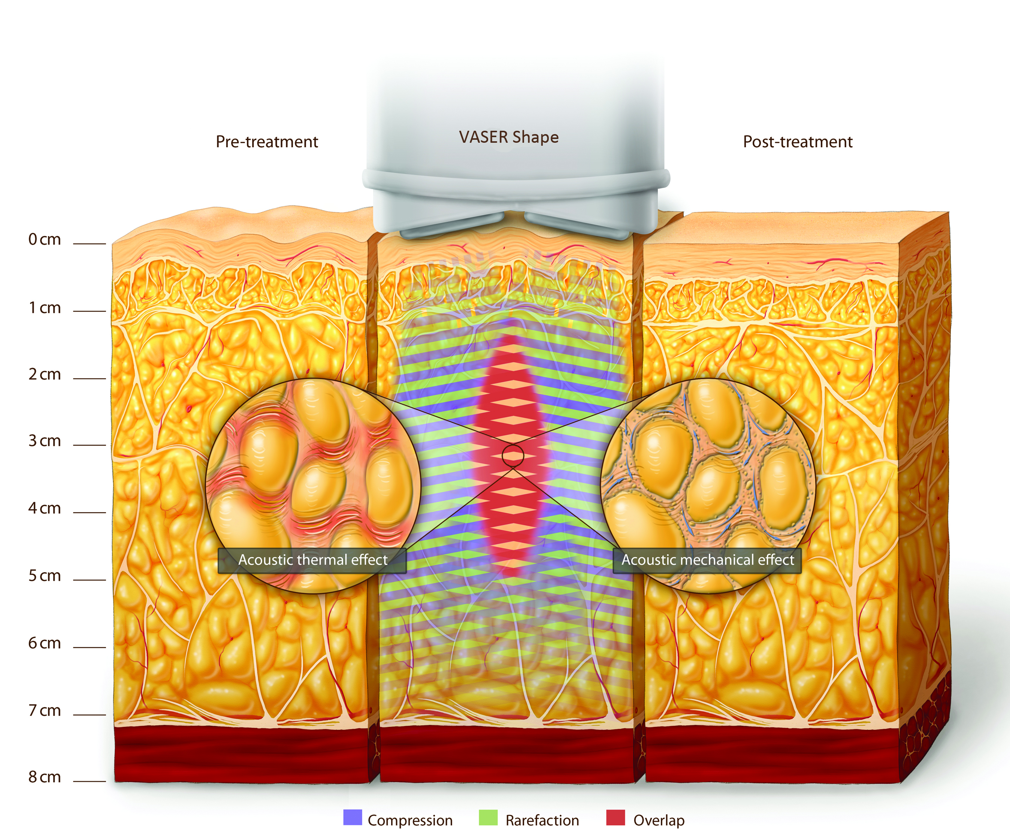
What Happens During a Treatment
Ultrasound energy warms the targeted area and treats the underlying fatty tissue causing fat cells to leak out their contents.

Slide 6
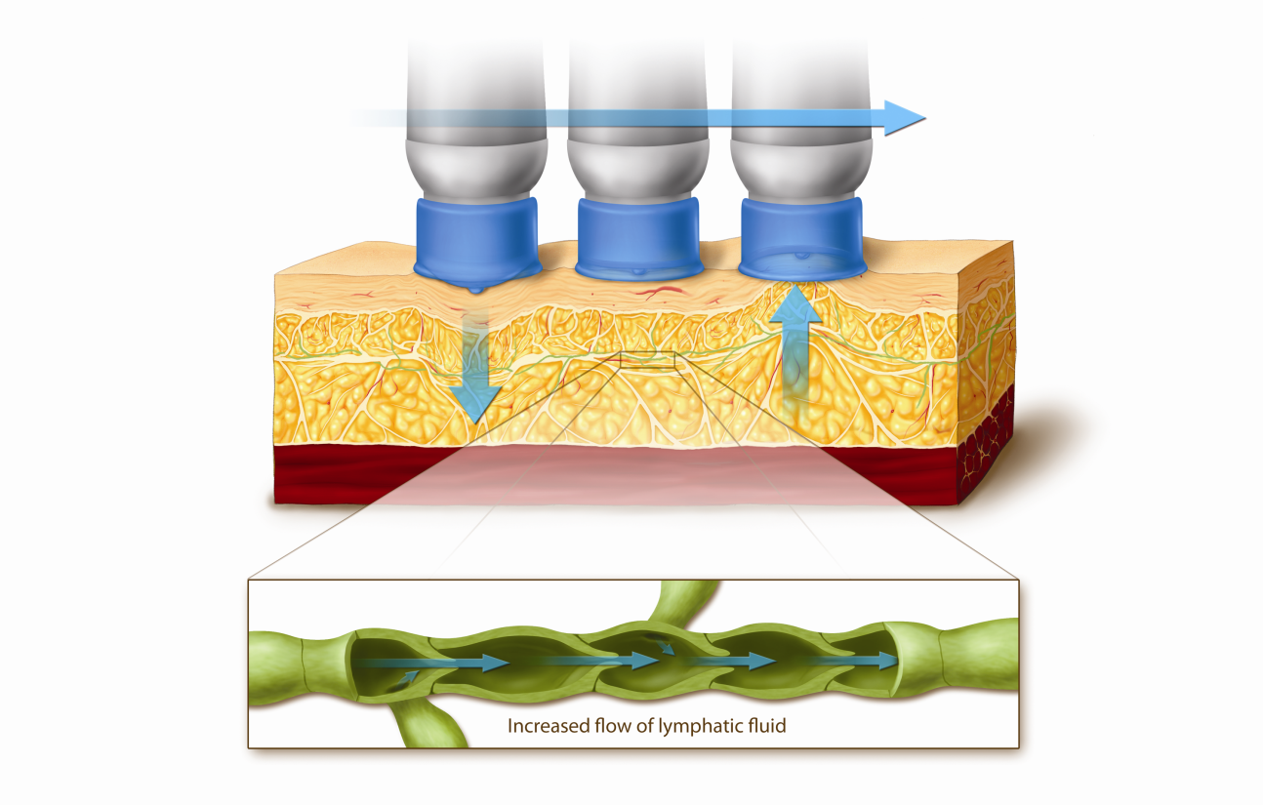
What Happens During a Treatment
Zonal massage helps to increase local blood circulation, open the lymph nodes, promote the metabolism and encourage the body to remove excess toxins.

Slide 7
The VASER® Shape Experience
You will be prescribed treatments based on your body type and the results you are hoping to achieve.
Typically, a treatment schedule will include:
One combined ultrasound and massage treatment per week, which typically lasts 30-45 minutes per body area
One zonal lymphatic massage session per week or manual massage at home
A total treatment regimen of three to five weeks

Slide 8
The VASER® Shape Experience Continued
Most patients describe the treatment as being similar to a hot rock massage.
Your skin may appear slightly pink and feel warm after the treatment due to the increased blood circulation in the treated area, but this should resolve itself within a few hours.
Physicians report that many patients notice significant improvement after the first session.
Following the treatment, you can resume normal activity without pain or downtime.

Slide 9
From VASER® Shape Patients Like You
“With just one VASER Shape treatment,
I am wearing my high school jeans again!”
~ Stefanie
“The entire experience was very comfortable.
The treatment is quick, painless and quite relaxing.”
~ AJ
“I saw improvement in my shape immediately
after the treatment, and my stomach feels even firmer
a few days later. I am looking forward to my next treatment.”
~ Elizabeth

Slide 10
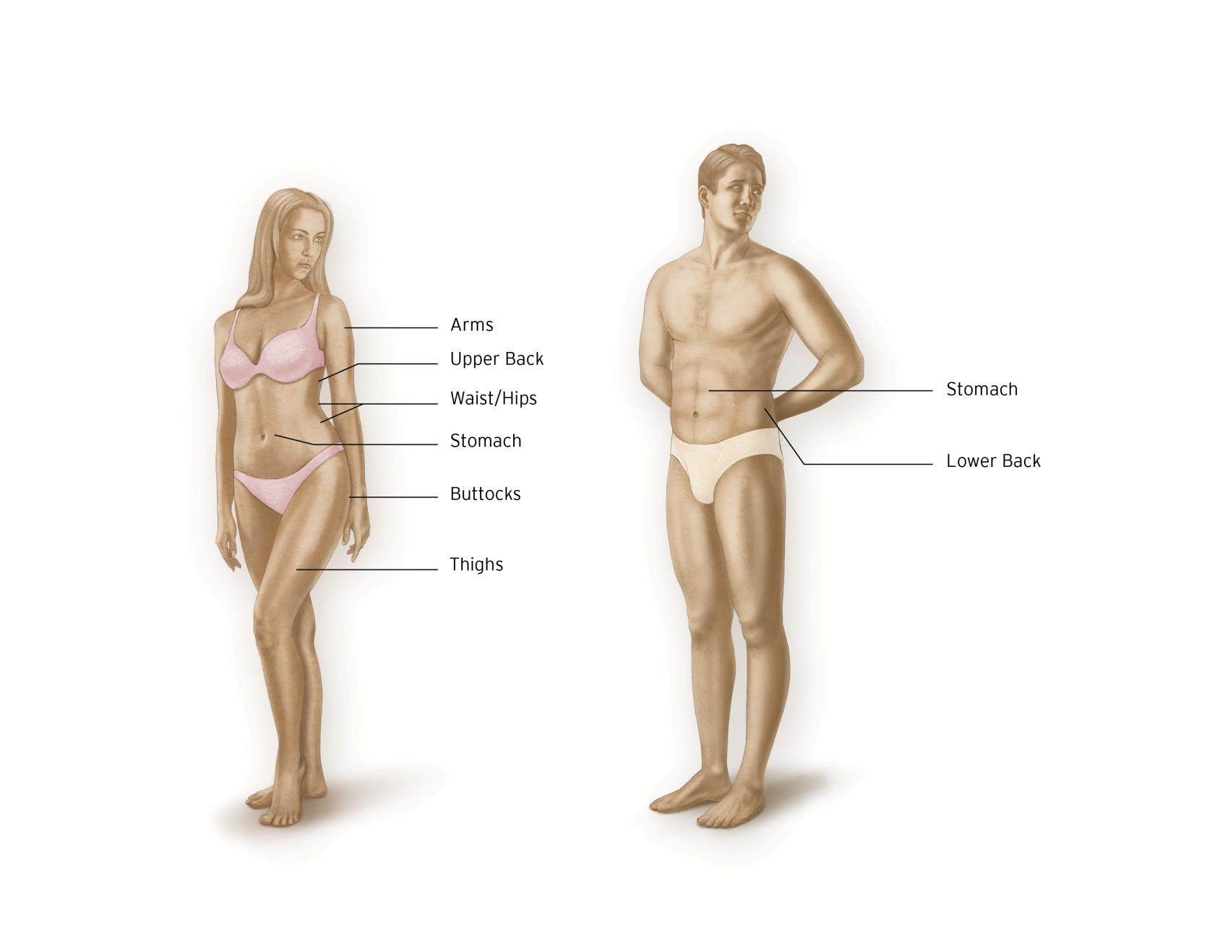
What Body Areas Can Be Treated

Slide 11
Candidacy Considerations
This procedure will smooth and
shape your body, but it is not a
weight loss solution.
Ideal candidates are not morbidly
obese.
Firm, elastic skin will produce the
best results.
Realistic expectations are essential.
Be honest about your goals and
expectations.

Slide 12
What Are the Next Steps?
Schedule a Consultation
Review Any Questions with Your Doctor
Take Measurements & Complete
Medical History
Capture Before Photographs
Undergo VASER® Shape Treatment(s)
Capture After Photographs
Enjoy the New You

Slide 13
Look Who’s Talking About VASER® Shape

Slide 14
A non-surgical treatment to smooth and shape your body.

